Slide 1
Introduction to Power BI
aka.ms/PL300-Course

Slide 2
Course objectives
After completing this course, you should be able to:
Retrieve and profile data from various sources, applying necessary transformations.
Design and implement a data model, enhancing it with DAX expressions, variables, and aggregations.
Create insightful reports and dashboards to effectively visualize data.
Perform advanced analytics to gain deeper insights from the data.
Manage workspaces, datasets, and row-level security settings for collaboration and data governance.

Slide 3
Audience profile
Candidates for this exam:
Leverage data and domain expertise to deliver insights.
Collaborate with stakeholders to identify business requirements.
Clean, transform, and model data by using Power BI.
Provide value through data visualizations and self-service analytics.
Deploy and configure solutions for consumption.
Use Power Query and DAX proficiently.

Slide 4



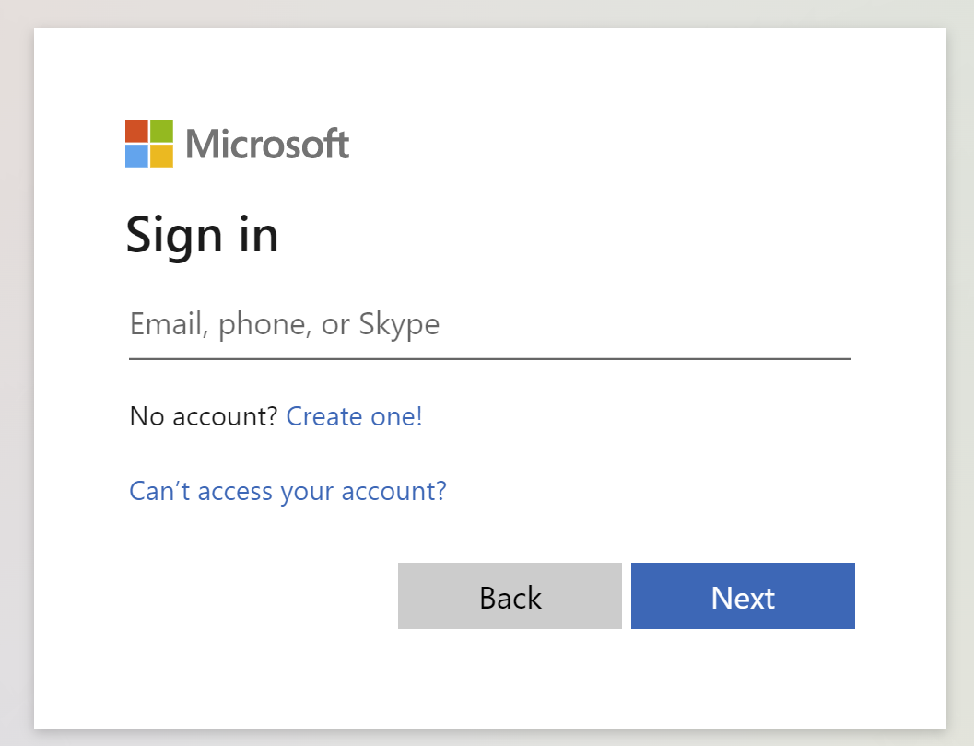
Get the most out of your Microsoft Learn profile
Create your Microsoft Learn profile at learn.microsoft.com
Select Sign in at the top, right corner of any Microsoft Learn page.
Follow the Microsoft account authentication process.
If the account that you have chosen to sign-in with doesn't already have a Microsoft Learn profile, you’ll be guided to create one.
Verify, track, and share your training and certification progress and accomplishments—all on one platform
Claim your achievement code for this course and share you have completed it.
Access your course material and track progress on your learning activities.
Share and verify your Microsoft Certifications via email, on social networking platforms, and on your résumé.
Download and print transcripts and certificates.
Manage your upcoming activities and certification exam appointments.
www.aka.ms/MyMicrosoftLearnProfile

Slide 5
Access your course material
All course content is available on Microsoft Learn
learn.microsoft.com/training/courses/browse
This course includes labs:
Detailed lab instructions are included in your lab environment.
We’ll go through this content together and as the course progresses, I will advise you on which modules to review.
You can provide feedback for modules on Microsoft Learn. Find how at the bottom of each page.
aka.ms/PL300-Labs

Slide 6
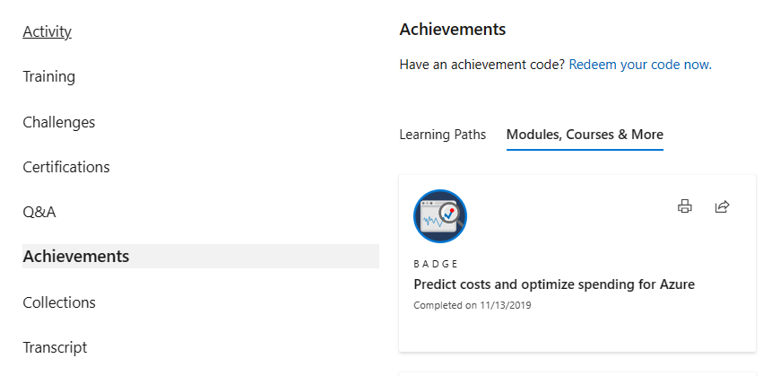
Celebrate your accomplishments and feel empowered
Get your achievement recognized and earn your badge for completing this course
aka.ms/MyMicrosoftLearnProfile
Go to Achievements on your Microsoft Learn profile
Redeem the code provided by your trainer
Find your new badge on Modules, Courses & More
Share your new achievement with your professional network. You can also download and print your certificate.
2
3
4
1

Slide 7

Become Microsoft Certified
92%
of certified IT professionals feel more confident in their abilities after earning certifications¹
Get recognized by earning industry validation for technical knowledge. Ensure you stay current with the necessary skills and expertise for continued success​.
Start at learn.microsoft.com/certifications
Microsoft role-based and specialty certifications require annual renewal.²
Learn about certification renewal at aka.ms/RenewYourCert
¹ “2023 Value of IT Certification | Candidate Report,” Pearson VUE, 2023 ² Microsoft fundamentals certifications don’t expire

Slide 8

Get ready for your Microsoft Certification exam
Exam PL-300: Microsoft Certified Power BI Data Analyst
Study area | Percentage
Prepare the data | 20-25%
Model the data | 15-20%
Visualize and analyze the data | 15-20%
Deploy and maintain assets | 20-25%
Exam preparation resources:
Watch exam prep videos
Review the exam study guide
Demo the exam experience with the exam sandbox
Take a practice assessment
Notes:
Percentages indicate the relative weight of each area on the exam.
The higher the percentage, the more questions you are likely to see in that area.

Slide 9
Class Link: | Business Intelligence and Data Warehouse BID3000 (PL-300)
Training Key: 7BB5FFD8E3424657

Slide 10
Get started with Microsoft data analytics
aka.ms/PL300-1

Slide 11
Agenda
Discover data analysis
Different data roles
Data analyst tasks
Get started with Microsoft data analytics
Data analytics with Microsoft
Building blocks of Power BI
Compelling visuals and reports

Slide 12
Discover data analysis

Slide 13
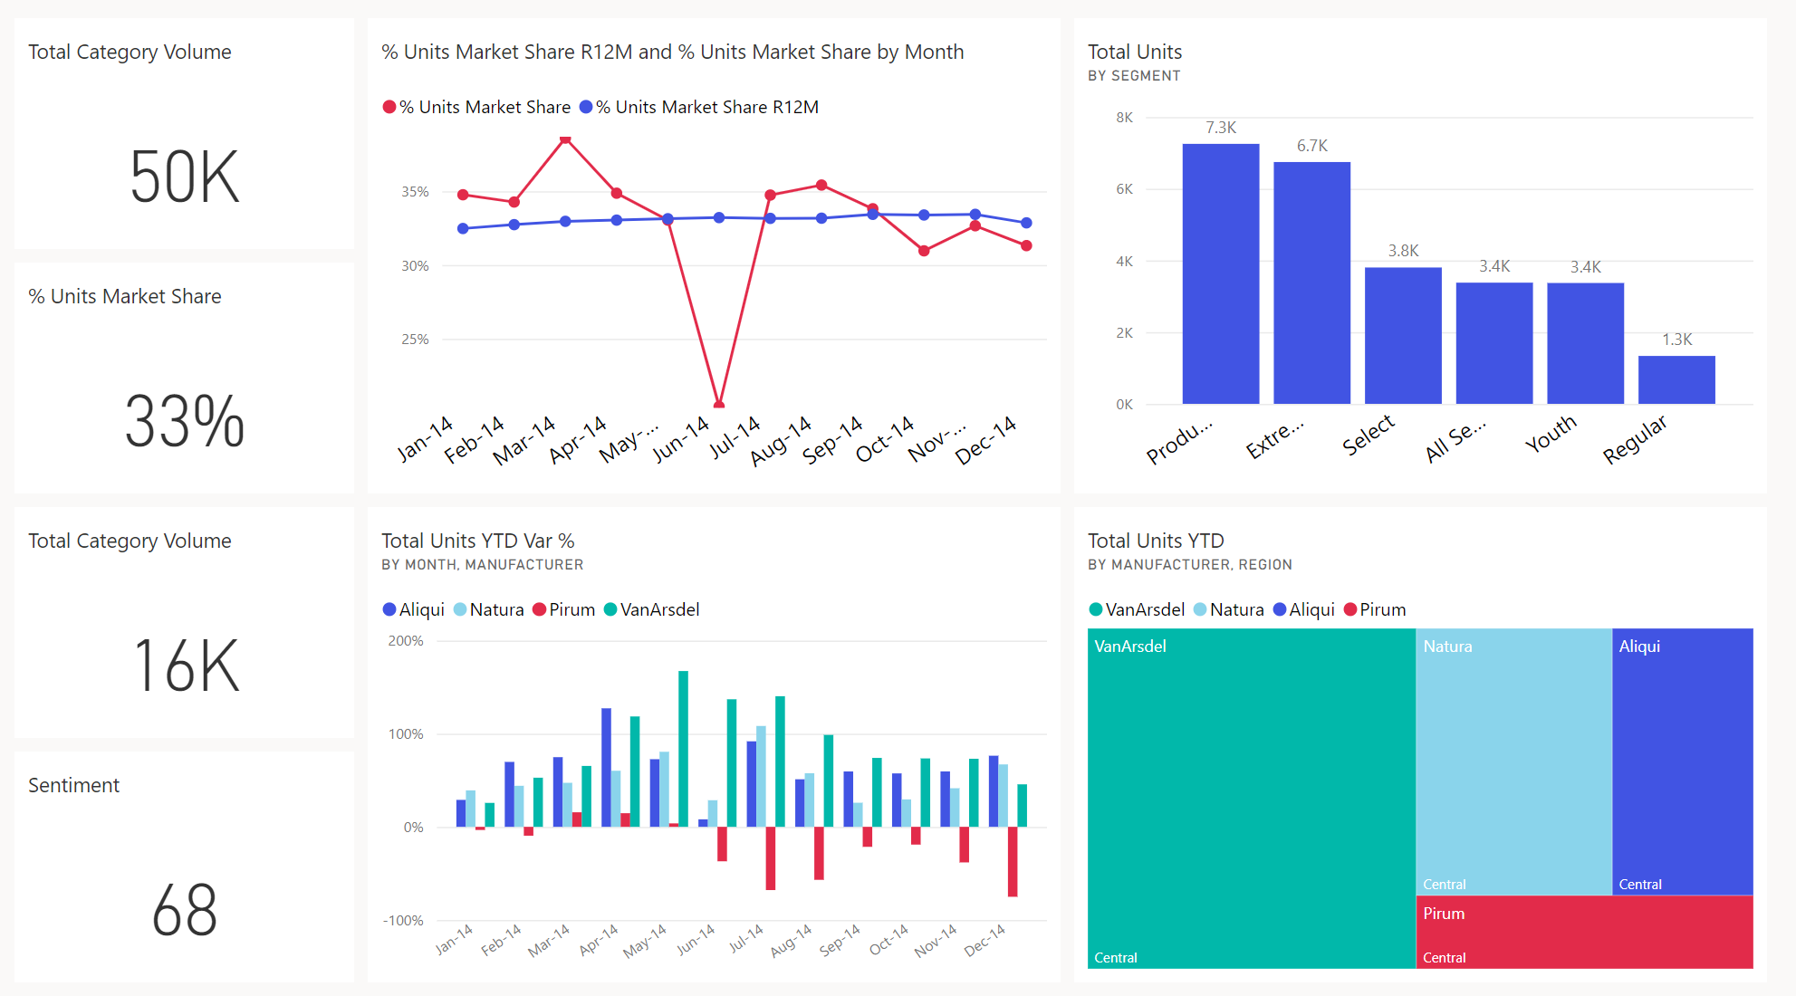



















From data to business insights with Power BI
Notes:
This graphic depicts that Power BI supports the transformation of raw or relational data into interactive visuals and business insights.
Data and information is the most strategic business asset.
As a data analyst, you are on a journey. Think about all the data that is being generated each day and that is available in an organization, from transactional data in a traditional database, telemetry data from services you use, to signals you get from different areas like social media.
Businesses of today collect and store massive amounts of data. Yet, businesses continue to struggle to use their data in a meaningful and productive way, which impacts their ability to act. Business should be able to use their vast amounts of data and information in such a way that impacts the business.
Business decision makers depend on an accurate story to drive better business decisions. The faster a business can make precise decisions, the more competitive they will be and the better advantage they will have.
The key to unlocking all this data is being able to tell as story with it via compelling and insightful reports.
Your journey of telling a story with data also ties into building that data culture within your organization. While telling the story is important, where that story is told is also crucial, making sure the story is told to the right people.

Slide 14
Different types of analysis
Data analysis is another form of storytelling with five categories:
Descriptive: Summarize past data
Diagnostic: Explain past data
Predictive: Forecast future data
Prescriptive: Optimize future data
Cognitive: Learn from data
Notes:
Before data can be used to tell a story, it must first be run through a process that makes it usable in the story. Thus, data analysis is the process of identifying, cleaning, transforming, and modeling data to discover meaningful and useful information. The data is then crafted into a story via reports for analysis to support the critical decision-making process.
While the process of data analysis focuses on the tasks of cleaning, modeling, and visualizing data, the concept of data analysis and how it is important to business should not be understated. To analyze data, core components of analytics are divided in the following categories:
As the world becomes more data-driven, storytelling through data analysis is becoming a more vital component and aspect of businesses large and small and is the reason organizations continue to hire data analysts.
Data-driven businesses make decisions based on the story their data tells, and in today's data-driven world, data is not being used t its full potential, a challenge that most business face today. Data analysis is and should be a critical aspect of all organizations to determine the impact to their business, including customer sentiment, market and product research, identify trends, or any other data insights.
Descriptive analytics helps answer questions about what has happened, based on historical data. Descriptive analytics techniques summarize large datasets to describe outcomes to stakeholders.
Diagnostic analytics techniques supplement more basic descriptive analytics. They take the findings from descriptive analytics and dig deeper to find the cause. The performance indicators are further investigated to discover why they got better or worse.
Predictive analytics techniques use historical data to identify trends and determine if they're likely to recur. Predictive analytical tools provide valuable insight into what may happen in the future.
Prescriptive: By using insights from predictive analytics, data-driven decisions can be made. This technique allows businesses to make informed decisions in the face of uncertainty.
Cognitive analytics helps you to learn what might happen if circumstances change, and how you might handle these situations, derive conclusions based on existing knowledge bases, and then add these findings back into the knowledge base for future inferences, a self-learning feedback loop.

Slide 15
Tasks of a Data Analyst
Prepare
Model
Visualize
Manage
Analyze
Notes:
Tasks of a data analyst
Now that you've looked at the who and the what, it's time to look at the how. You already know that a data analyst is one of several critical roles in an organization, helping uncover and make sense of information to keep the company balanced and operating efficiently. As such, it's vital that you, as a data analyst, clearly understands your responsibility and the tasks that are performed on a near-daily basis. The skillset of a data analyst is essential in helping organizations gain valuable insights into the expanse of data they have, working closely with others in their respective roles in the organization to help bring to light valuable information.
As such, there are five key areas that you'll engage in during the data analysis process.
Prepare
As a data analyst, you'll probably spend most of your time split between the prepare and model tasks. Bad or incorrect data can have a major impact, resulting in invalid reports, a loss of trust, and can negatively affect business decisions, which lead to loss in revenue, a negative business impact, and more.
Model
Once the data is in a proper state, it's ready to be modeled. Data modeling is the process of determining how your tables are related to each other. This is done by defining, and creating, relationships between the tables. From there, you can enhance the model by defining metrics and adding custom calculations to enrich your data.
Visualize
This task is where you get to bring your data to life! The goal of the visualize task is to ultimately solve business problems. A well-designed report should tell a compelling and impactful story about that data, enabling business decision makers to quickly gain needed insights. Using appropriate visualizations and interactions, an effective report guides the reader through the content quickly and efficiently, allowing the reader to follow a narrative into the data.
Analyze
The Analyze task is the important step of understanding and interpreting the information that is displayed on the report. In your role as a data analyst, you should understand the analytical capabilities of Power BI and use those to find insights, identify patterns and trends, predict outcomes, and then communicate those insights in such a way that everyone can understand.
Manage
There are many components in Power BI, including reports, dashboards, workspaces, datasets, and more. As a data analyst, you are responsible for the management of these Power BI assets, overseeing the sharing and distribution of items such as reports and dashboards, and ensuring the security of Power BI assets.

Slide 16
Knowledge check: data analytics
Which role enables advanced analytics capabilities through reports and visualizations?
Data analyst
Data engineer
Data scientist
Which data analyst task has critical performance impact on reporting and data analysis?
Analyze
Model
Visualize
What is a key benefit of data analysis?
Decisive analytics
Informed business decisions
Complex reports

Slide 17
Get started building with Power BI

Slide 18
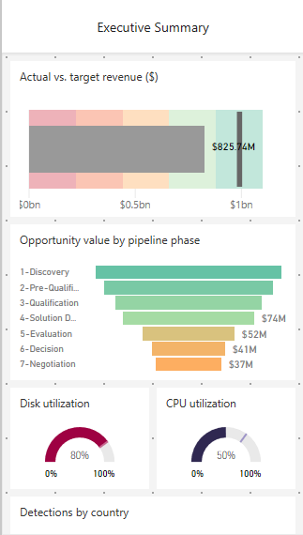
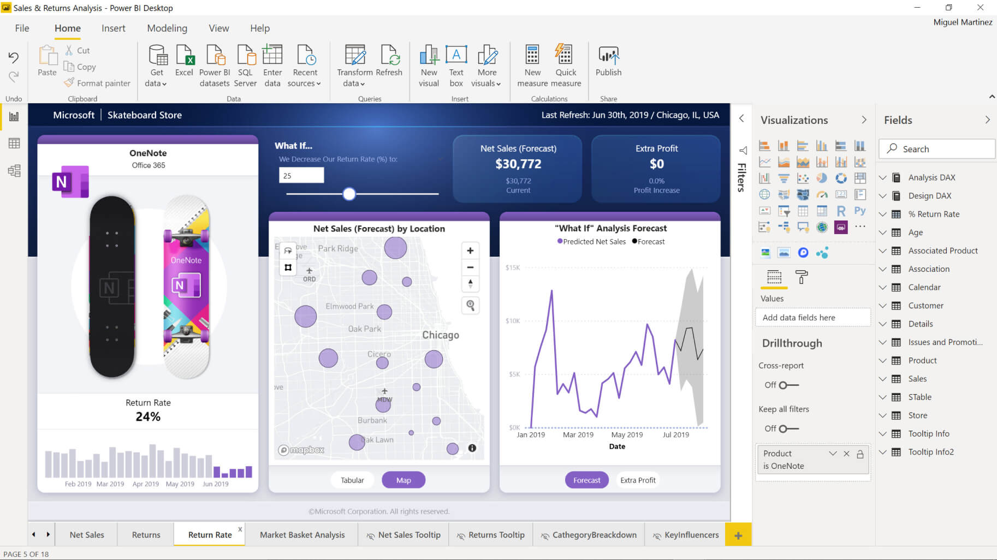
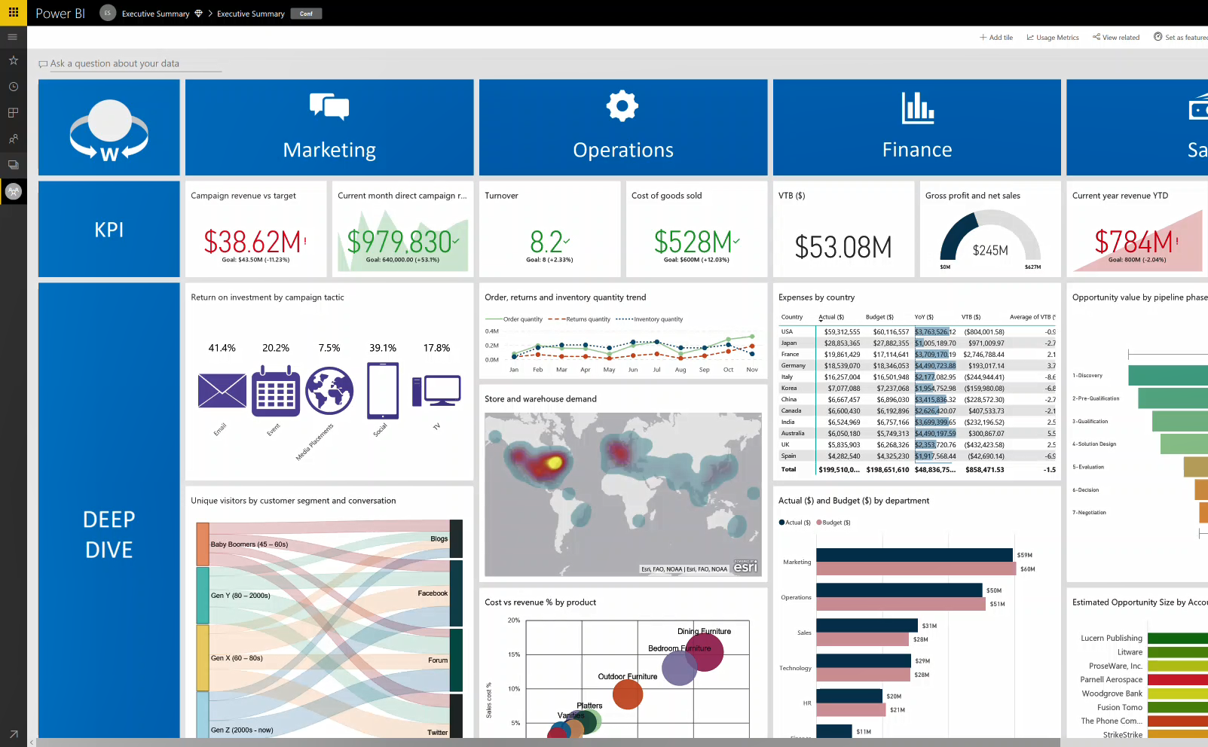
Introduction to Power BI environment
Create with Power BI Desktop
Distribute with Power BI service
Access with Power BI Mobile
Notes:
Microsoft Power BI is a collection of software services, apps, and connectors that work together to turn your unrelated sources of data into coherent, visually immersive, and interactive insights. Whether your data is a simple Microsoft Excel workbook, or a collection of cloud-based and on-premises hybrid data warehouses, Power BI lets you easily connect to your data sources, visualize (or discover) what's important, and share that with anyone or everyone you want.
Desktop: A free application you install on your local computer that lets you connect to, transform, and visualize your data.
Service: A SaaS service which brings together dashboards, workspaces, reports, and datasets for keeping a finger on the pulse of your business.
Mobile: Connect to and interact with your cloud and on-premises data. You create reports in Power BI Desktop. You create dashboards, and view dashboards and reports in the Power BI report service. You view on-premises Power BI reports on Power BI Report Server. All these reports and dashboards are available in the Power BI mobile apps, whether they're on premises or in the cloud.
How you use Power BI might depend on your role on a project or a team. And other people, in other roles, might use Power BI differently, which is just fine.

Slide 19


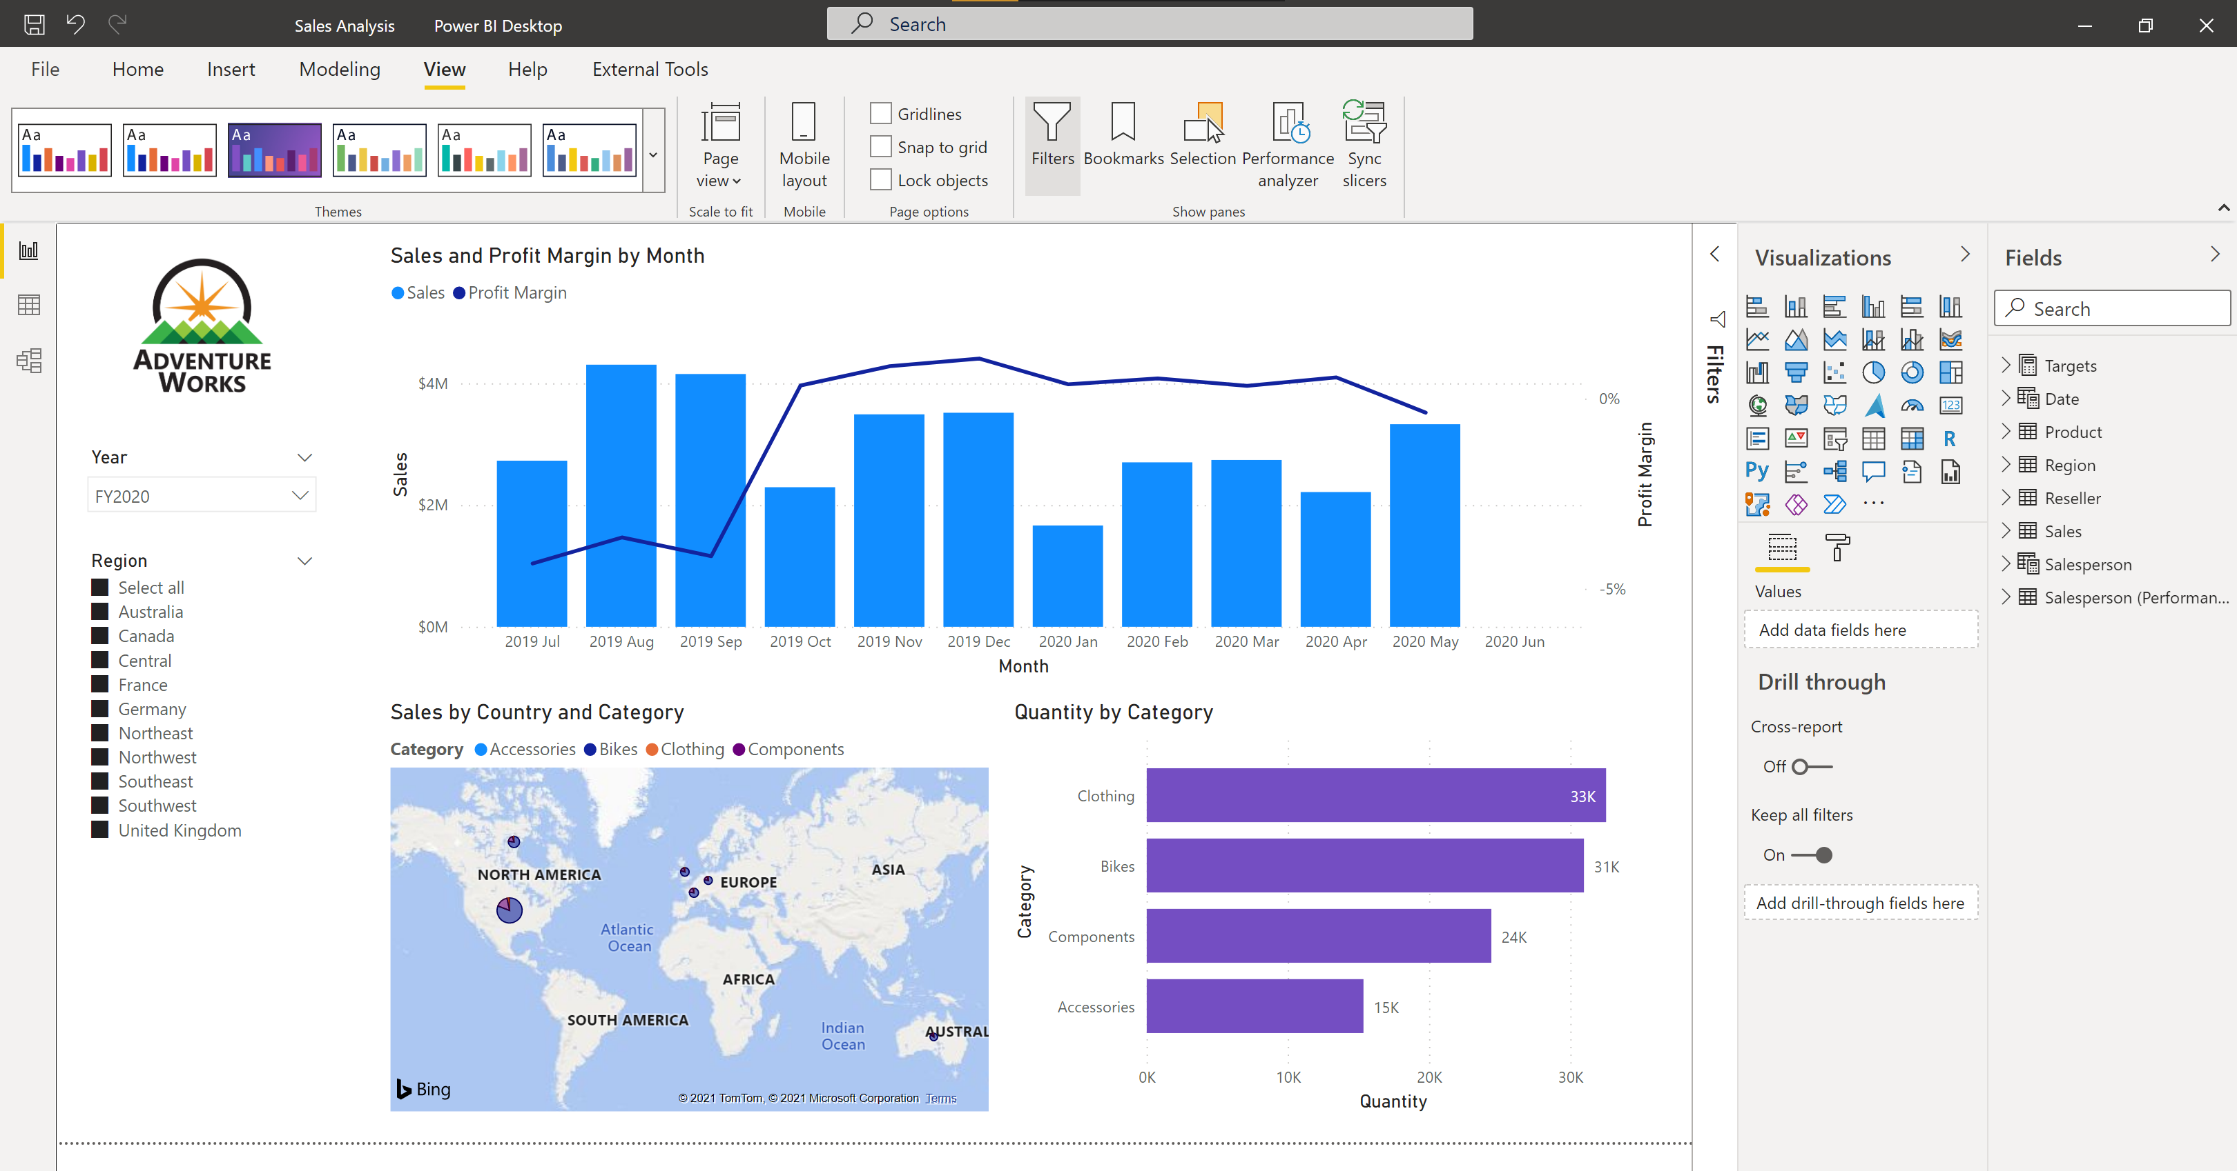




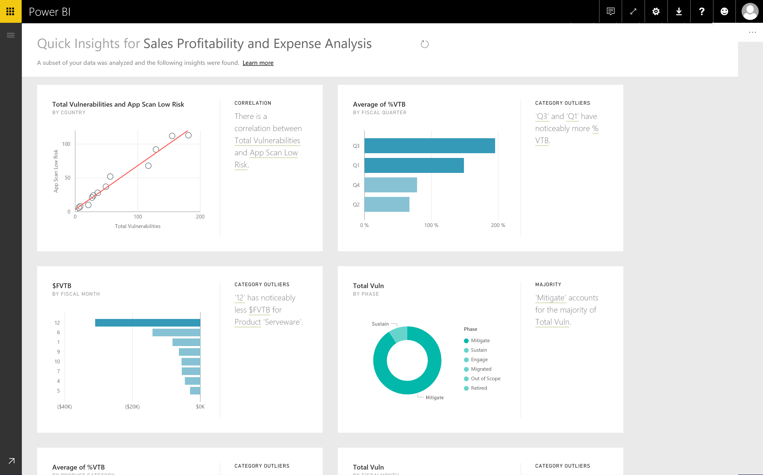
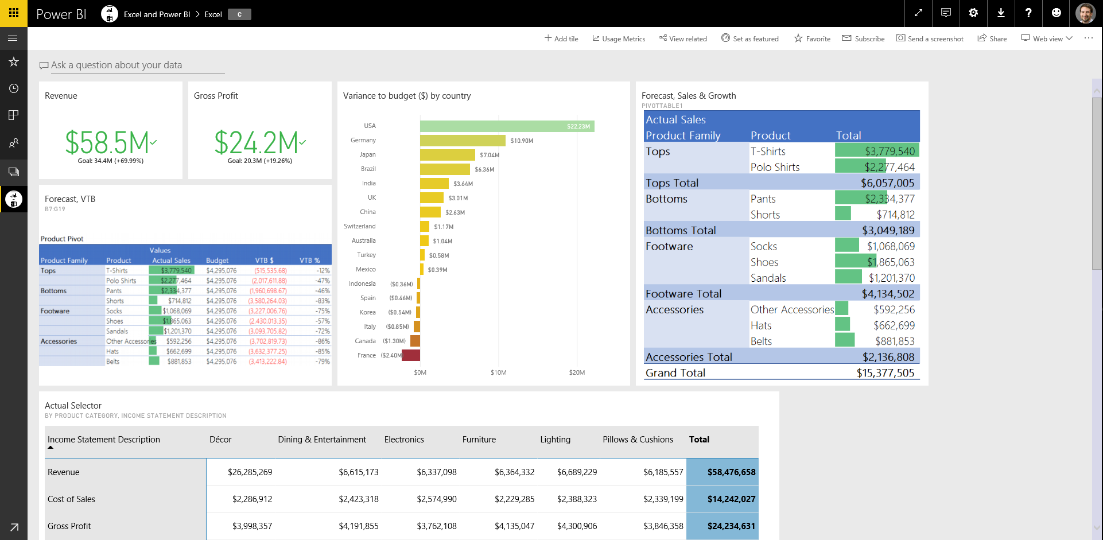
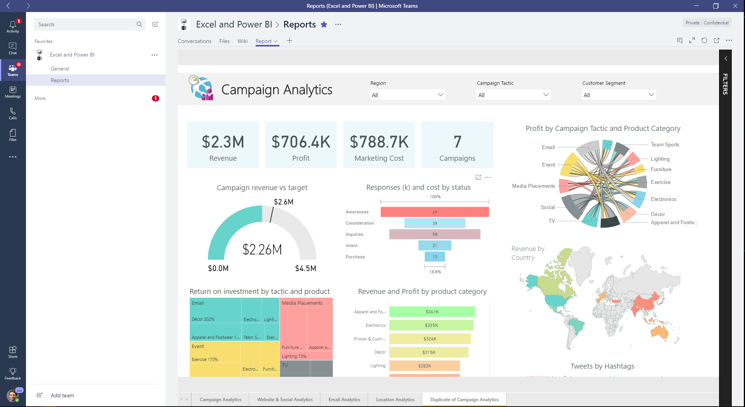
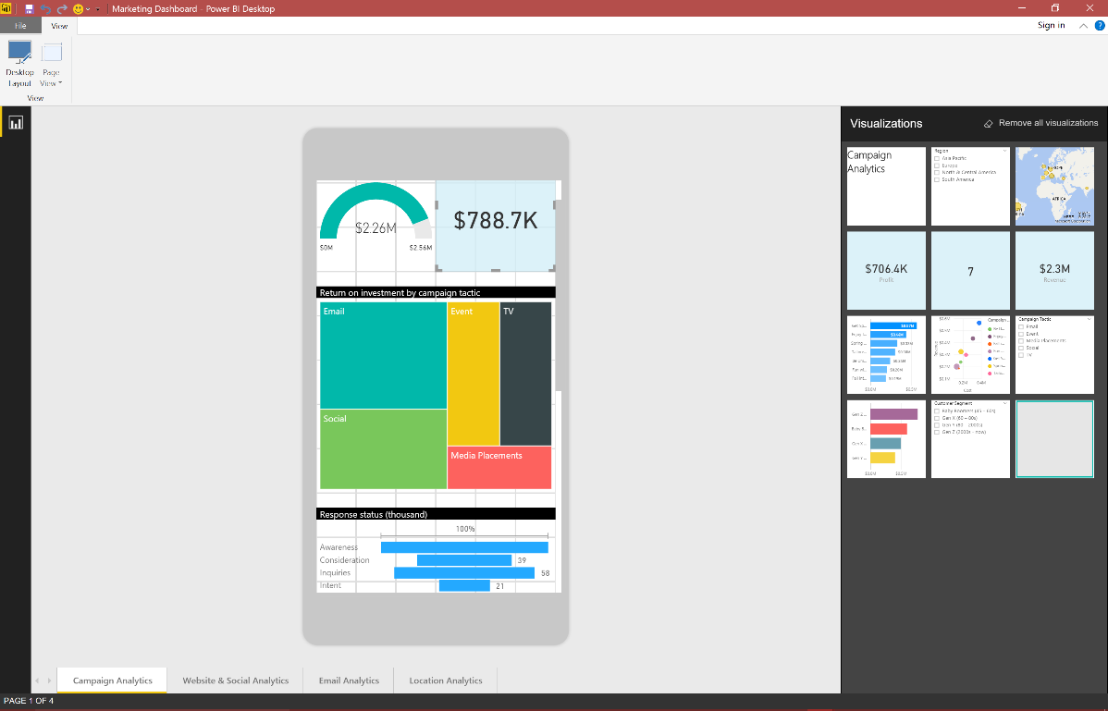

The flow of Power BI
Data sources
Power BI Desktop
Power BI service & Mobile
Notes:
The activities and analyses that you'll learn with Power BI generally follow a common flow. The common flow of activity looks like this:
Bring data into Power BI Desktop and create a report.
Publish to the Power BI service, where you can create dashboards and apps to easily share your content.
Distribute reports and dashboards with apps and target the audience appropriately.
View and interact with shared dashboards and reports in Power BI Mobile apps.

Slide 20
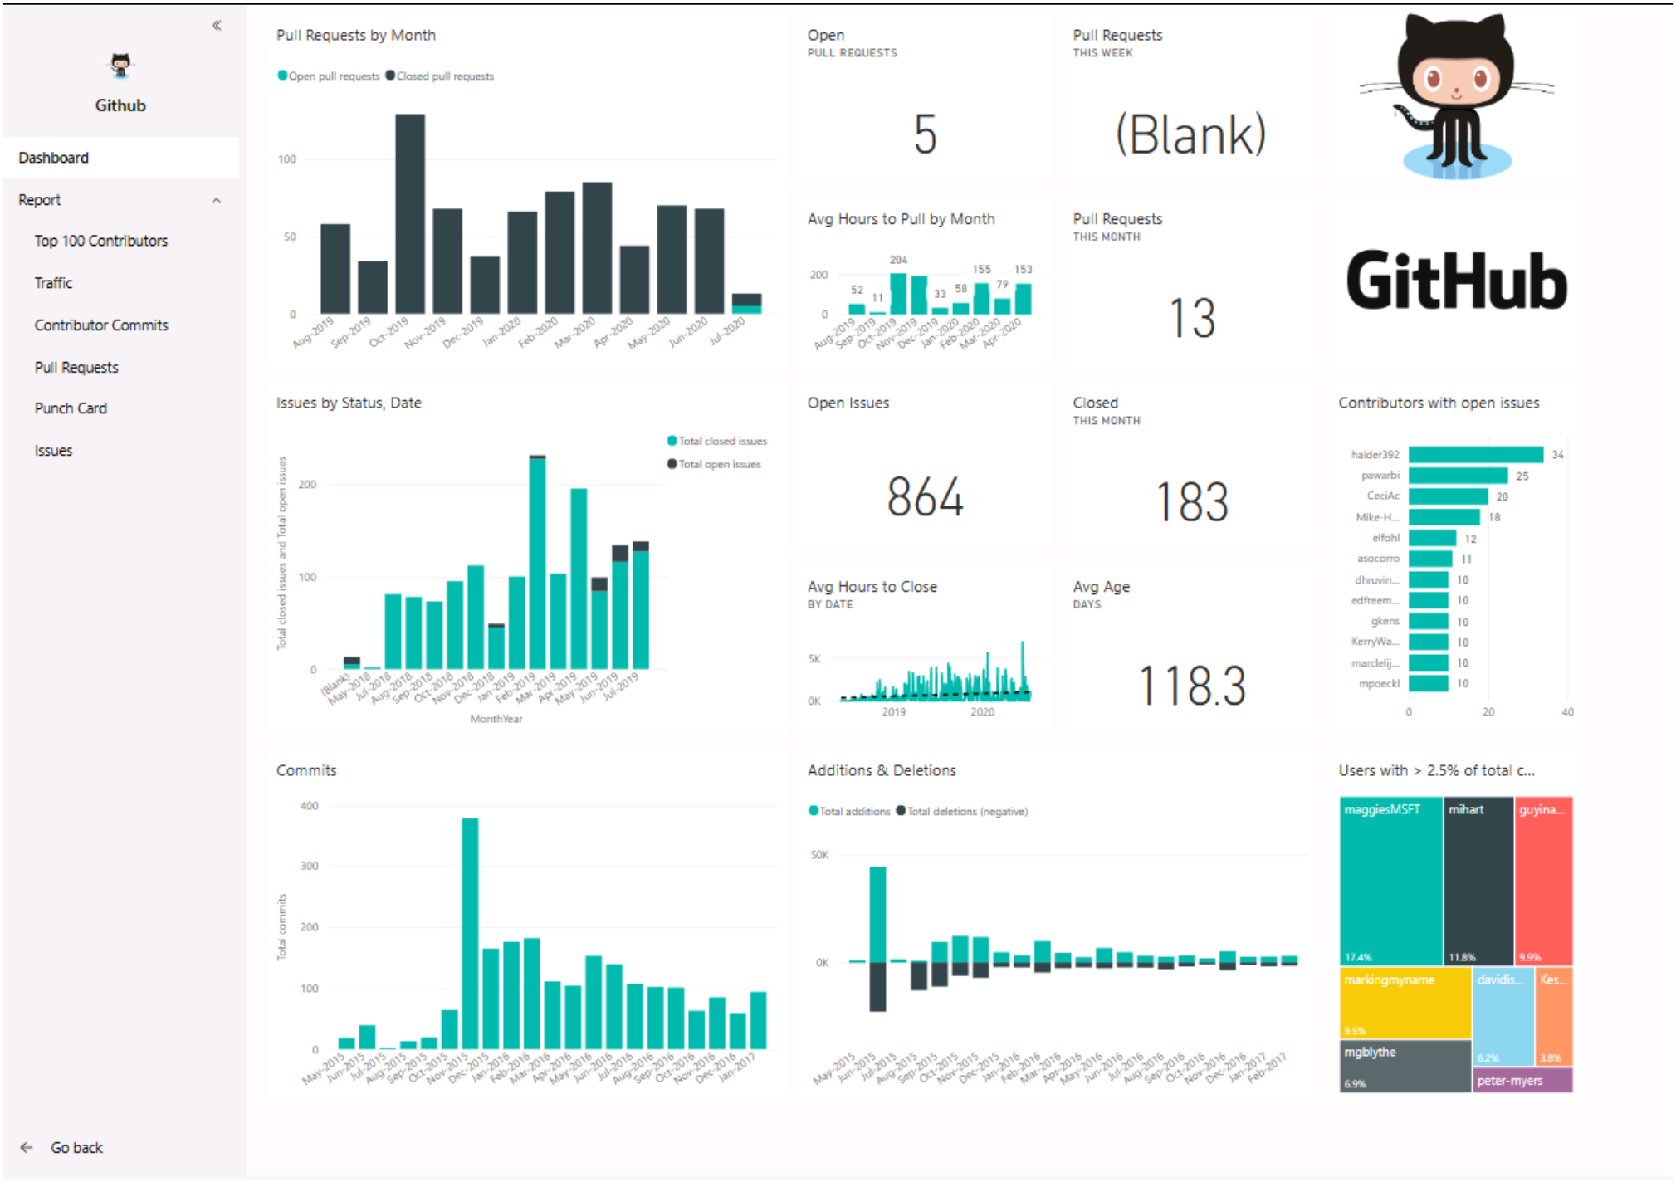
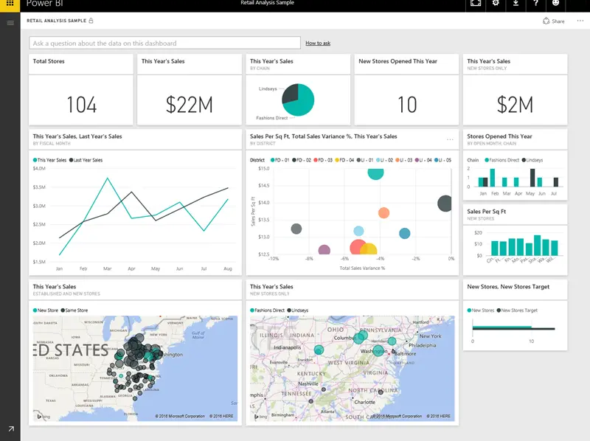
Building blocks of Power BI service
Consumable read-only reports and custom apps to enhance distribution.
Single-page dashboards can be derived from reports in the service.
Notes:
Once a report has been developed, you want to distribute to the appropriate audience. After you publish the report, you can view it in the Power BI service. You can also create an app for easy distribution, as well as dashboards. Here, we see a report shared through an app and a dashboard.

Slide 21
Demo
Get started with Microsoft data analytics

Slide 22
Knowledge check: building blocks
What is the common flow of activity in Power BI?
Load data and create a report in Power BI Desktop, publish to Power BI service to view, then distribute via app.
Create a report in the Power BI service, share it to Power BI mobile, interact with it in Power BI Desktop.
Bring data into Power BI mobile, create a report, then share it to Power BI Desktop.
Which of the following are building blocks of Power BI?
Tiles, dashboards, databases, mobile devices.
Visualizations, datasets, reports, dashboards, tiles.
Visual Studio, C#, and JSON files.
What is a collection of reports and dashboards called in Power BI?
Canvas.
Scheduled refresh.
App.
Notes:
Use the slide animation to reveal the correct answers.

Slide 23
Recap
In this section, we:
Discovered the concept of data analysis with Microsoft.
Reviewed roles in data and the tasks of a data analyst.
Explored building blocks of Power BI applications and services.

Slide 24
Thanks
Resources
Discover data analysis
Get started with Power BI

